Slide 1
Apex resume & portfolio builder
IBM PROJECT
Presented By:
Student Name- Vedant Vinod Rakshe
College Name- B.K. Birla College
Department- Sy. BSc. Data Science

Slide 2
OUTLINE
Problem Statement
Proposed System/Solution
System Development Approach
Algorithm & Deployment
Result
Conclusion
Future Scope
References

Slide 3
Problem Statement
AI Resume & Portfolio Builder
Many students struggle to present their skills and projects in an attractive, professional format. Generic resume
templates don’t highlight individual strengths. A generative AI solution is needed that can automatically generate
tailored resumes, cover letters, and portfolios based on student data, improving job and internship opportunities.

Slide 4
Proposed Solution
The Apex Suite: A unified, AI-powered web application hub offering two dedicated generation tracks.
Track A (Resume Builder): A multi-step guided wizard that takes rough, informal user notes and transforms them into a professional, executive-style PDF resume.
Track B (Portfolio Builder): A dedicated pipeline that converts brief project descriptions and "about me" notes into a structured, 6-slide PowerPoint (.pptx) presentation.
Core Benefit: Automates the drafting and formatting process entirely, allowing users to focus on content rather than document design.

Slide 5
System Approach
Frontend & User Interface: Streamlit (enables rapid development of interactive web apps with built-in session state management for the multi-step wizard).
AI Engine (The Brain): Groq API utilizing the llama-3.3-70b-versatile model for ultra-fast, high-quality text generation and formatting.
Document Generation: * fpdf2: For dynamic, programmatic construction of PDF resumes.
python-pptx: For native assembly and exporting of PowerPoint slides.
Environment & Security: python-dotenv for local API key management and Streamlit Secrets for cloud security.

Slide 6
Algorithm & Deployment
Algorithm & Logic:
Mega-Prompting Architecture: Instead of making multiple API calls for different resume sections, all user inputs are bundled
into a single, comprehensive prompt. This drastically reduces API rate-limiting (429 errors) and speeds up generation.
Native JSON Forcing: The system strictly commands the LLM to output machine-readable JSON formats
{"type": "json_object"}. This prevents formatting crashes and allows the Python backend to reliably map the AI's text to the PDF/PPTX templates.
Deployment:
Hosted on Streamlit Community Cloud.
Continuous integration via GitHub using a strictly defined requirements.txt to manage dependencies.
.

Slide 7
Result
A fully functional, live web application accessible from any browser.
Users can successfully input messy, lowercase notes and, within seconds, download a perfectly formatted PDF resume or a structured PPTX portfolio.
The system successfully handles the AI payload in a single, rapid request, avoiding the typical freezing or crashing associated with heavy API reliance.

Slide 8
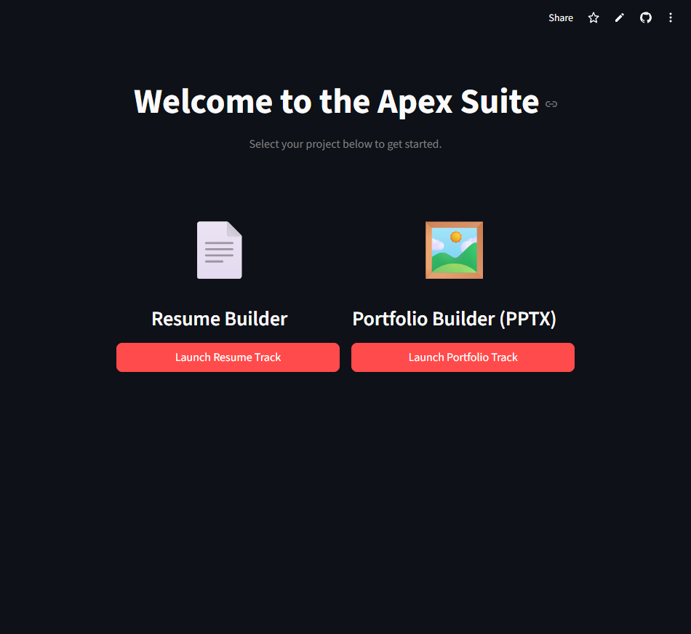
Project Images

Slide 9
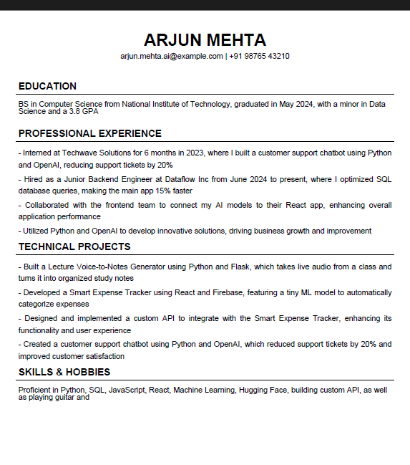
Project images

Slide 10
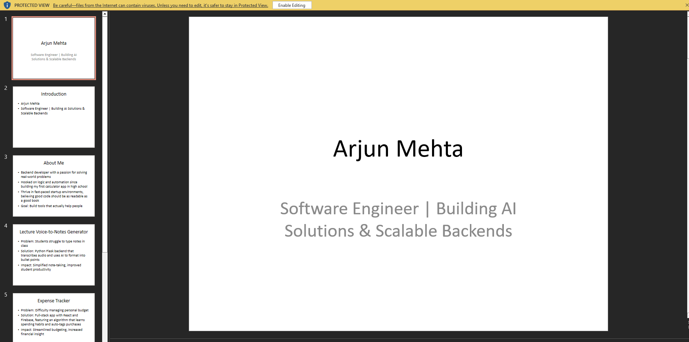
Project images

Slide 11
Conclusion
The Apex Suite successfully bridges the gap between raw candidate experience and professional presentation.
By leveraging high-speed LLMs (Groq) and robust document-generation libraries, the system eliminates the most tedious, repetitive parts of job application prep. It proves that complex formatting and professional copywriting can be effectively automated into a seamless user experience.

Slide 12
Future scope
"Bring Your Own Key" (BYOK) Integration: Adding an input field for users to provide their own API keys, preventing the central developer key from being exhausted as user traffic scales.
Dynamic Theming: Implementing customizable color palettes, fonts, and layout options for the PDF and PPTX exports.
Direct Job Matching: A feature allowing users to paste a specific Job Description (JD), prompting the AI to automatically tailor the generated bullet points to highlight matching skills.

Slide 13
References
Streamlit Documentation (docs.streamlit.io)
Groq API & Llama 3 Series Documentation (console.groq.com/docs)
fpdf2 Python Library Documentation
python-pptx Library Documentation

Slide 14
Github link
GitHub Link : https://github.com/VR-95
Deployment Link: https://d7aniasiqnmkdvcc4gd5z4.streamlit.app/

Slide 15
THANK YOU

